Slide 1




Database
SQL Server 2012 Express Installation

Slide 2
Pre-Requisites
Dot-Net Framework 3.5 SP1 or later
Microsoft windows installer 4.5 (http://go.microsoft.com/fwlink/?LinkId=159623)
Windows power shell (http://www.microsoft.com/downloads/en/details. aspx?familyid=6CCB7E0D-8F1D-4B97-A397- 47BCC8BA3806&displaylang=en )
Download the SQL Server 2012 express from: https://www.microsoft.com/en- us/sqlserver/editions/2012-editions/express.aspx

Slide 3

Installation Steps

Slide 4



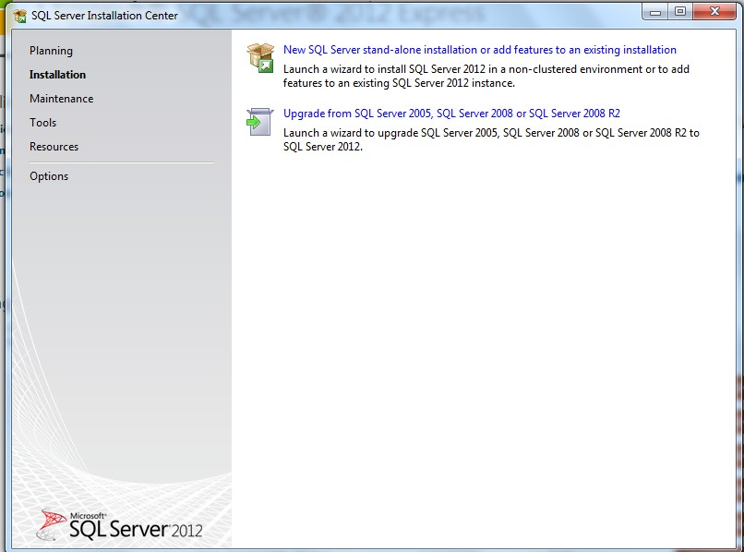
Choose “New SQL Server Stand-alone Installation or add features to an existing installation”.

Slide 5

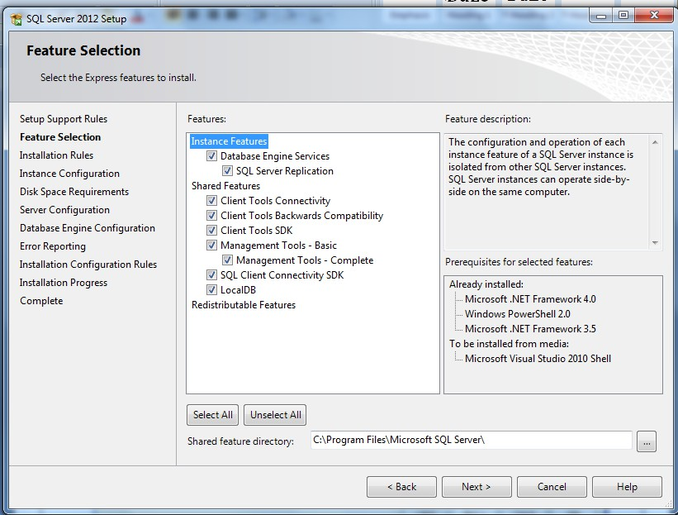
Select All Features

Slide 6

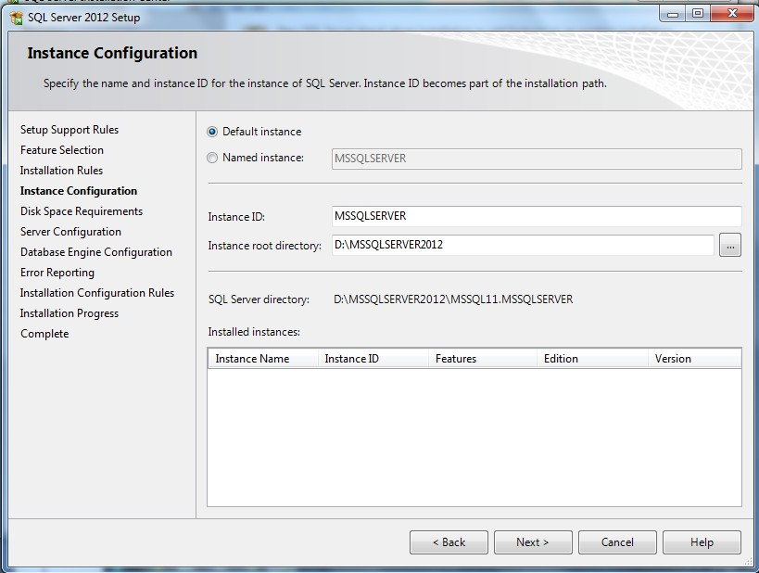
Select Default Instance

Slide 7

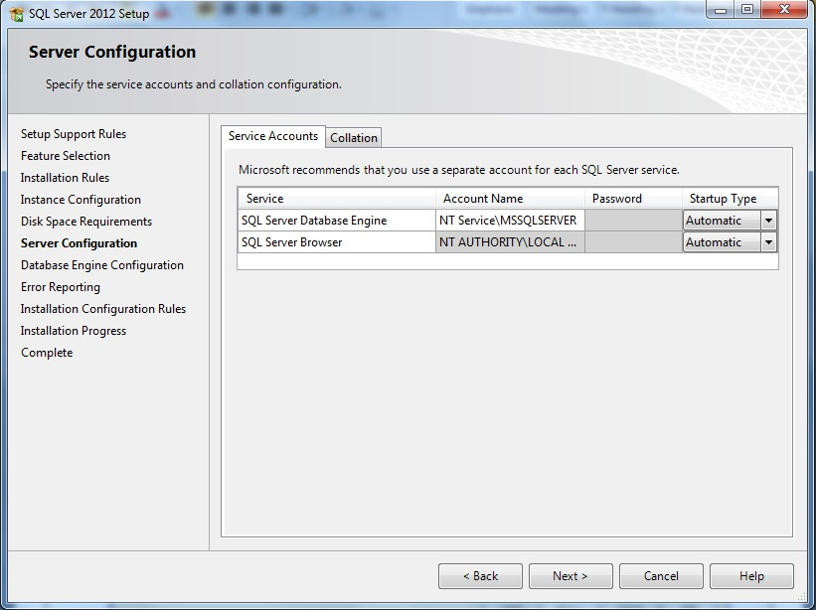
Change Startup Types to Automatic

Slide 8




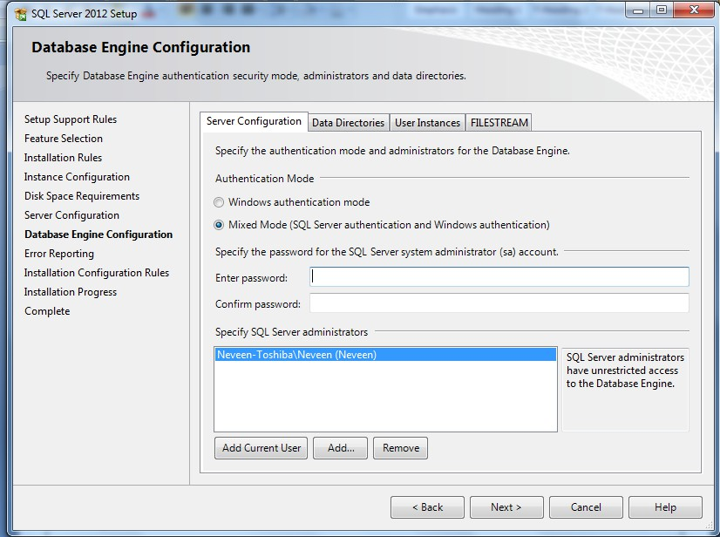
Choose for Authentication “Mixed Mode” and set sa Password

Slide 9

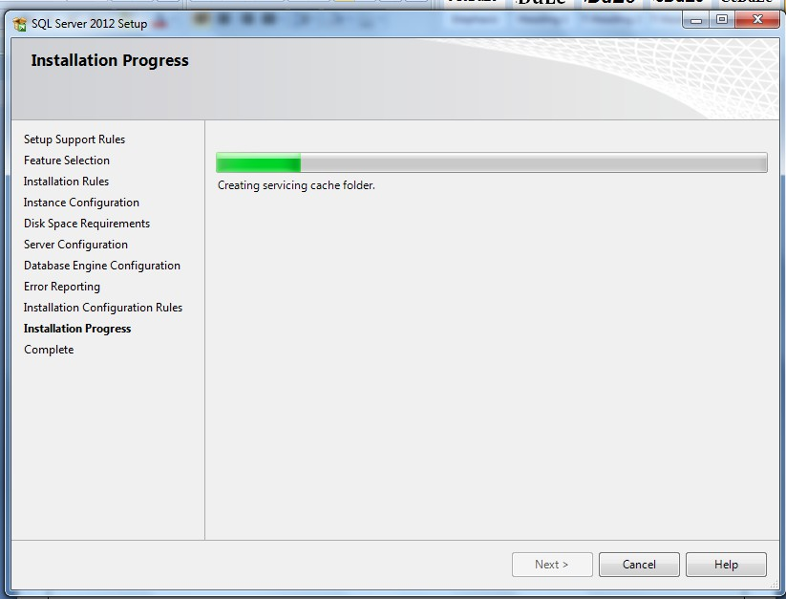
Installation in Progress

Slide 10

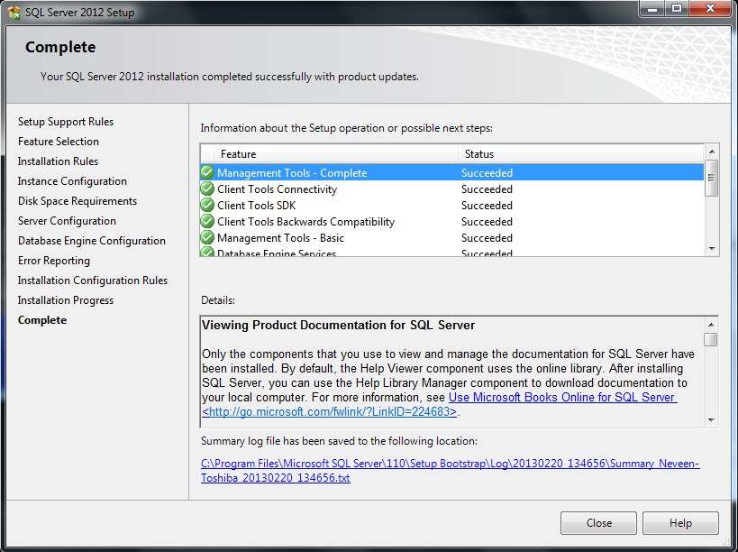
Installation Success

Slide 11

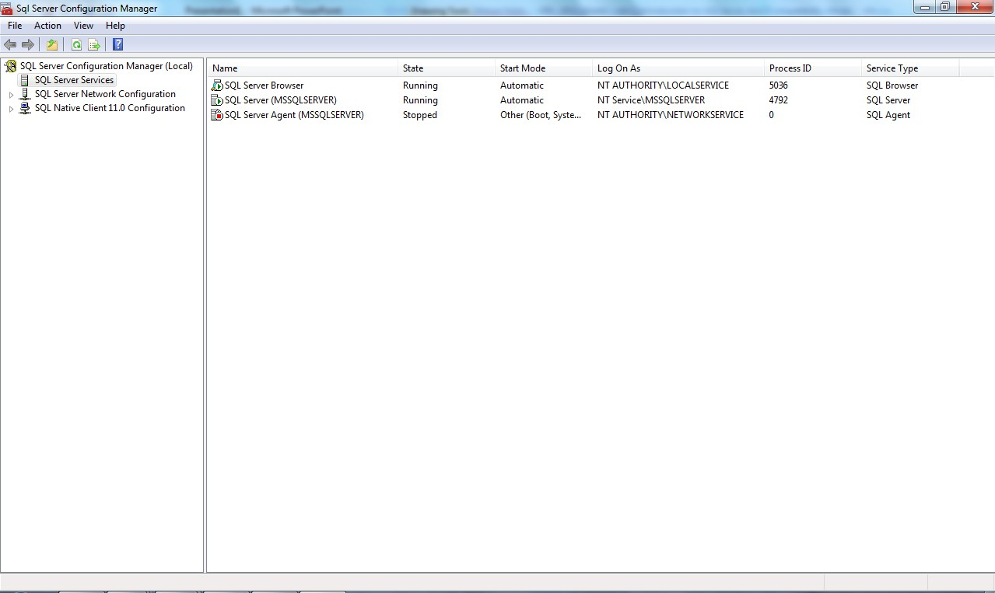
SQL Server Configuration Manager

Slide 12


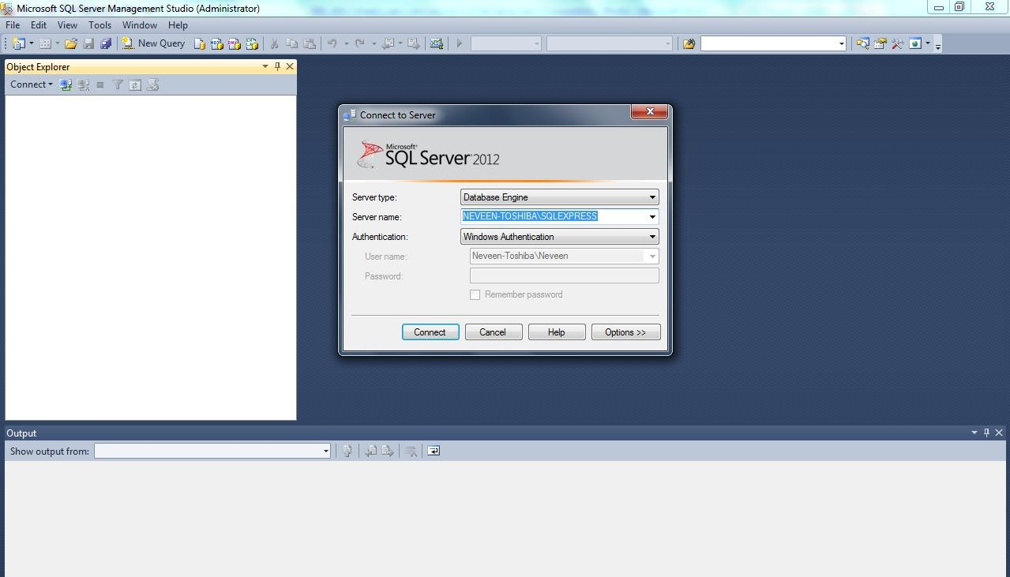
SQL Server Management Studio (Connecting to Database Server)

Slide 13

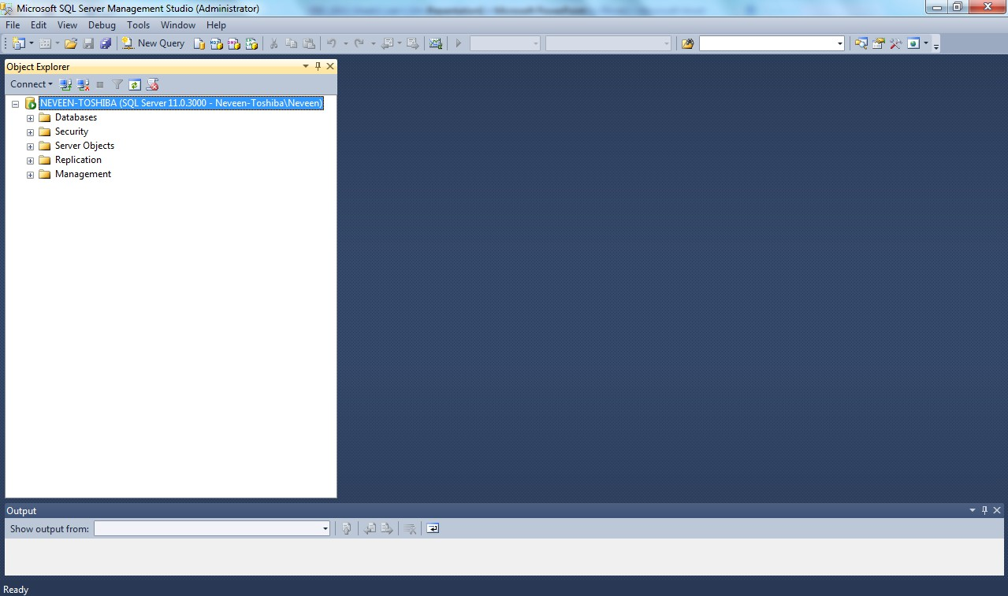
SQL Server Management Studio

